Slide 1
Heart Disease Classification

Slide 2
Dataset

Slide 3
Attributes
Demographic factors:
Sex – categorical nominal
Age category – categorical nominal
Race – categorical nominal
BMI (Body Mass Index) – numerical continuous
Unhealthy habits:
Smoking - categorical nominal
Alcohol drinking - categorical nominal
General health:
General health – categorical ordinal
Mental health – numerical continuous
Physical health – numerical continuous
Sleep time – numerical discrete
Difficulty walking - categorical nominal
Physical activity - categorical nominal
Classification attribute:
Heart disease – categorical nominal

Slide 4
Examining attributes before preprocessing

Slide 5
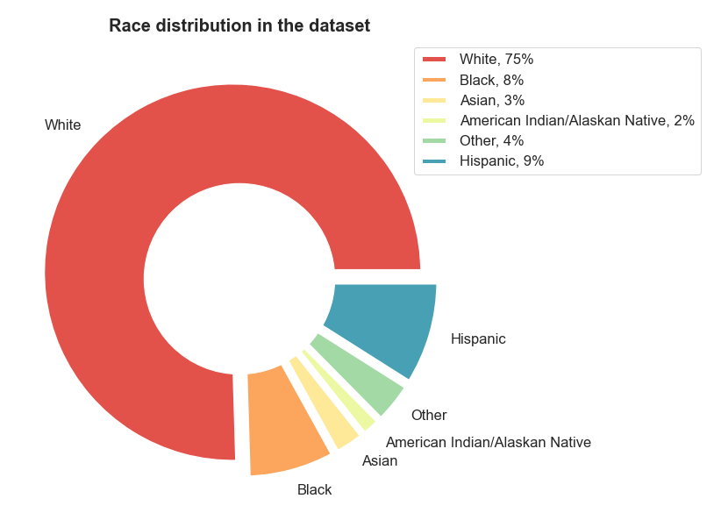
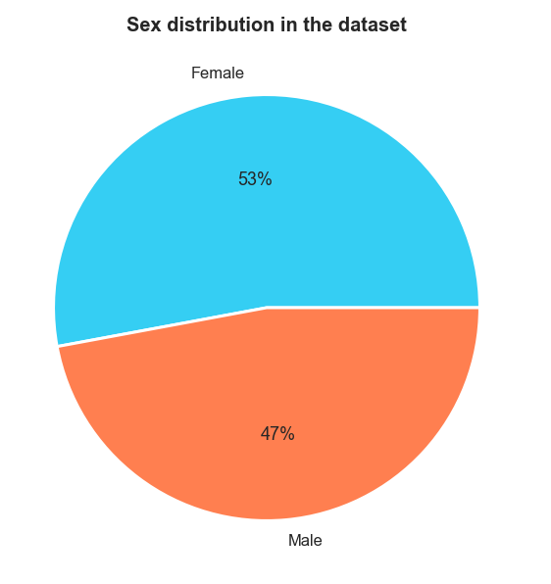

Slide 6
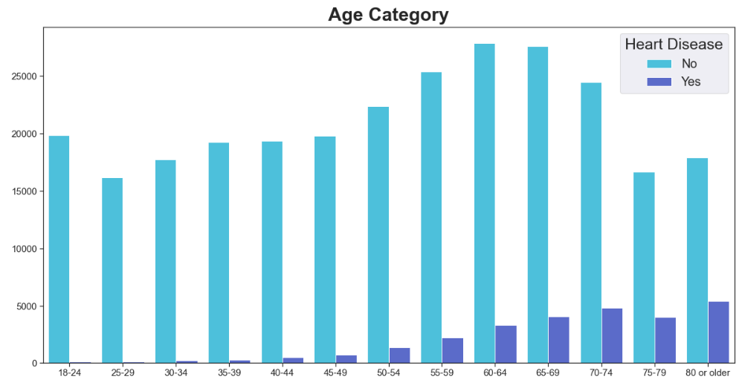
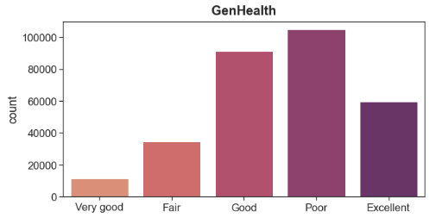

Slide 7
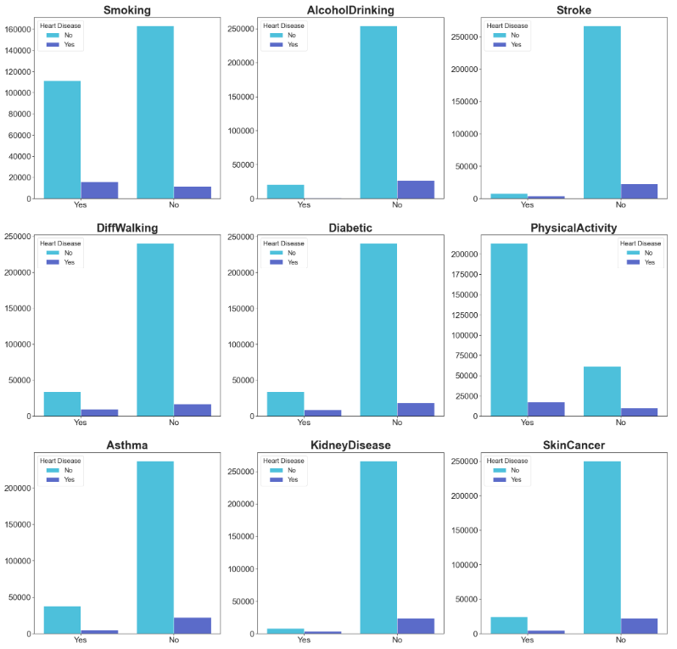
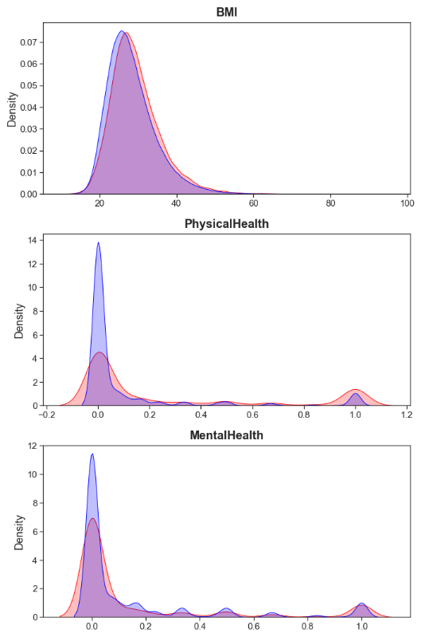

Slide 8
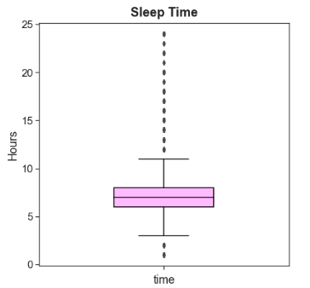
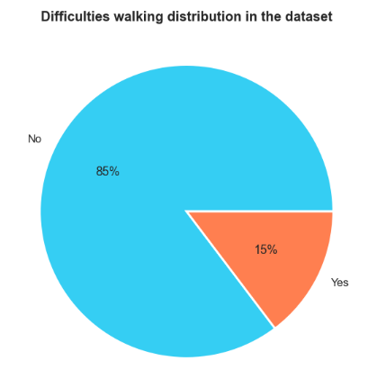

Slide 9
Aim
Comparison of “Heart Disease” label prediction of three classification algorithms, namely:
K-nearest neighbors
Decision Tree (optimized version of the CART algorithm)
Naïve Bayes

Slide 10
Preprocessing

Slide 11
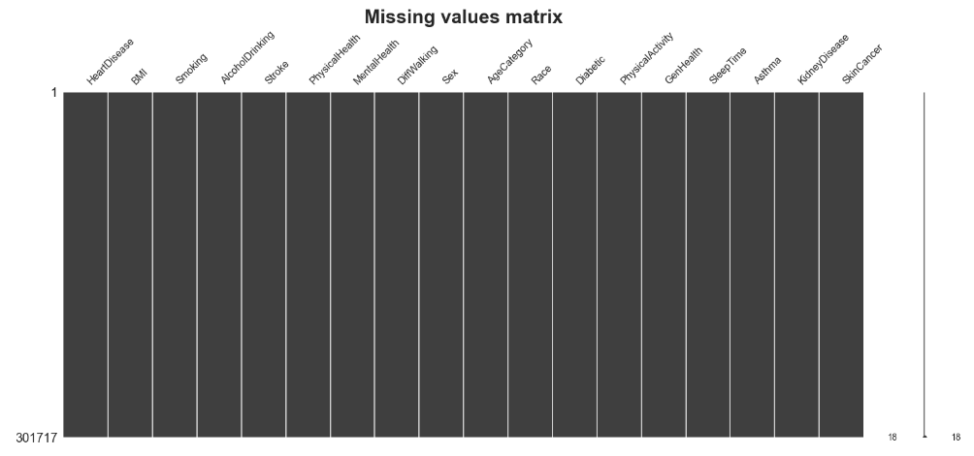
Handling missing values

Slide 12

Duplicates
It was found that the dataset contains 18 078 duplicates (out of approximately 340 000 samples)

Slide 13
Format "Diabetic" attribute to "Yes"/"No" form
It was noticed that “Diabetic” attribute has two additional values apart from “Yes” and “No”, which are:
'No, borderline diabetes’
'Yes (during pregnancy)'

Slide 14
Converting non-numerical attributes into numerical
"Sex" attribute:
Female = 1
Male = 0
"GenHealth" attribute:
Poor = 1
Fair = 2
Good = 3
Very Good = 4
Excellent = 5
"Race" attribute:
'White' = 1
'Black' = 2
'Asian' = 3
'American Indian/Alaskan Native' = 4
'Hispanic' = 6
'Other' = 5
“Yes"/"No" value columns to binary
"AgeCategory" attribute:
'18-24' = 1
'25-29' = 2
'30-34' = 3
'35-39' = 4
'40-44' = 5
'45-49' = 6
'50-54' = 7
'55-59' = 8
'60-64' = 9
'65-69' = 10
'70-74' = 11
'75-79' = 12
'80 or older' = 13

Slide 15
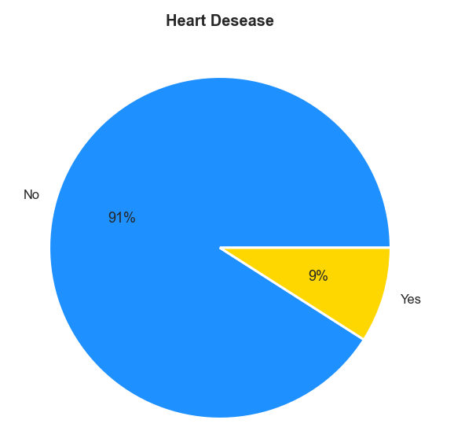
Checking if data is imbalanced

Slide 16
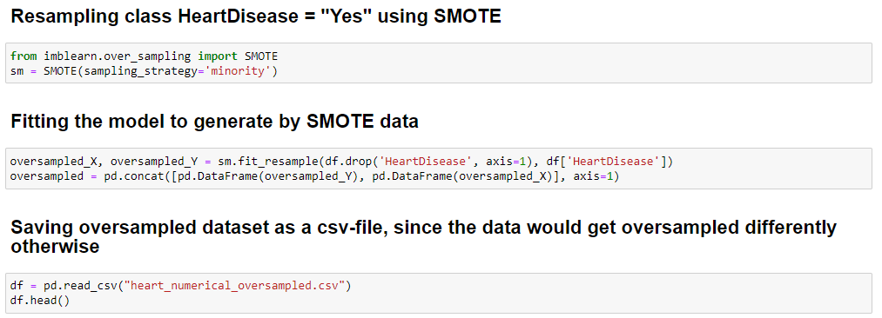
Dealing with imbalanced data
Since the data is highly imbalanced, it was decided to resample the minority class (i.e., “HeartDisease” = "Yes") using SMOTE method from “imblearn” library.

Slide 17
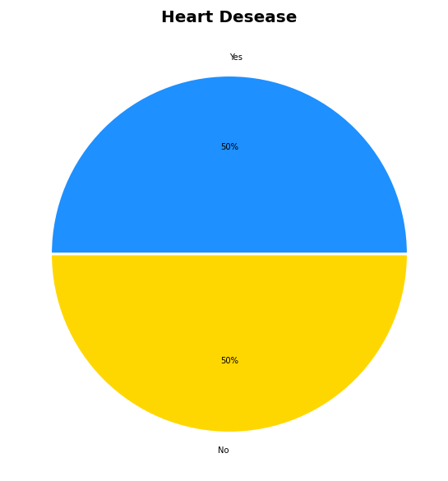
“HeartDisease” “Yes”/”No” labels proportion after preprocessing

Slide 18
Plots after data preprocessing

Slide 19
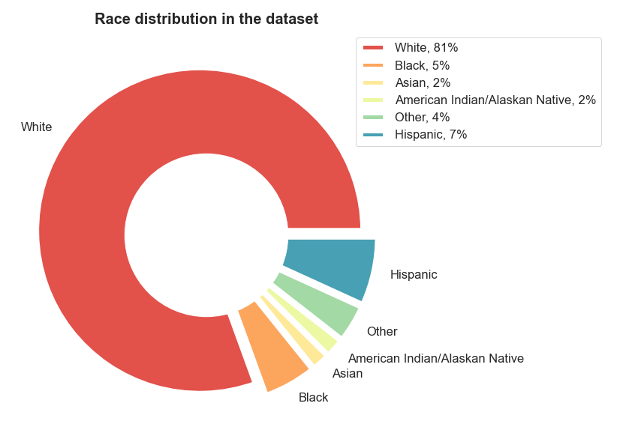
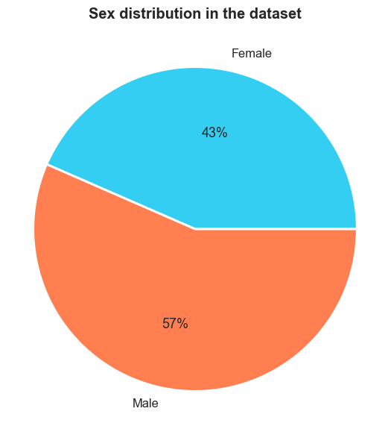

Slide 20
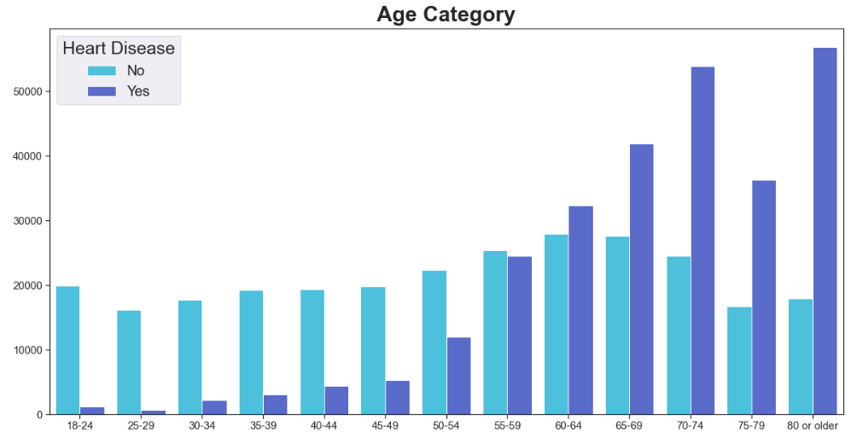
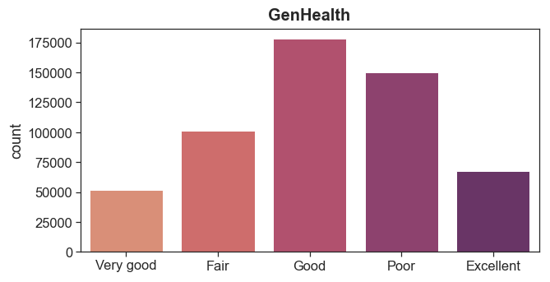

Slide 21
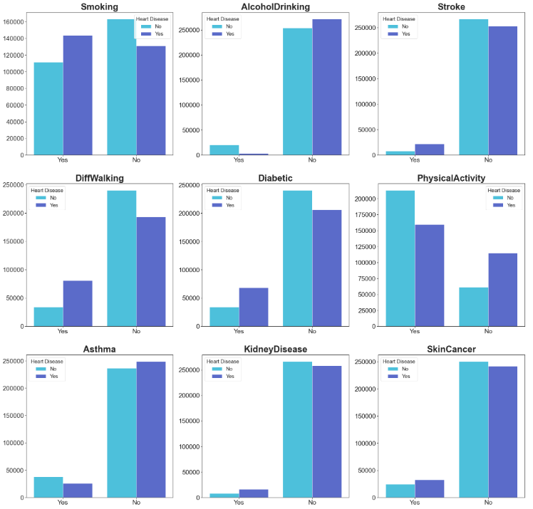
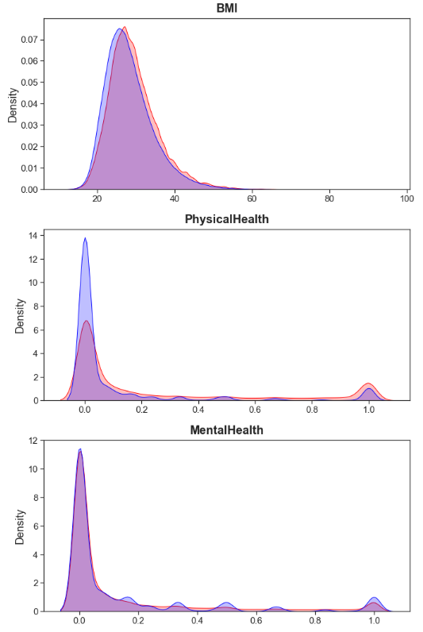

Slide 22
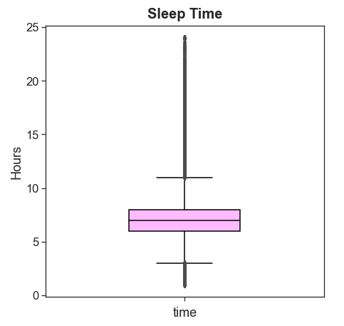
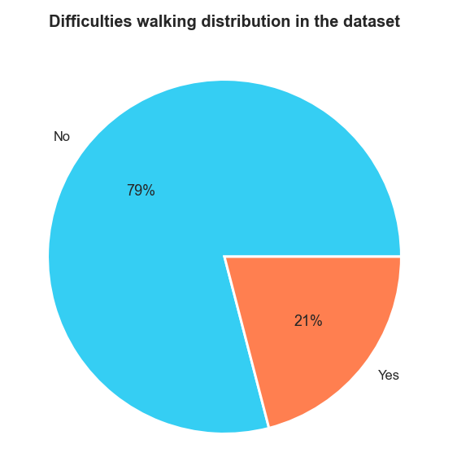

Slide 23
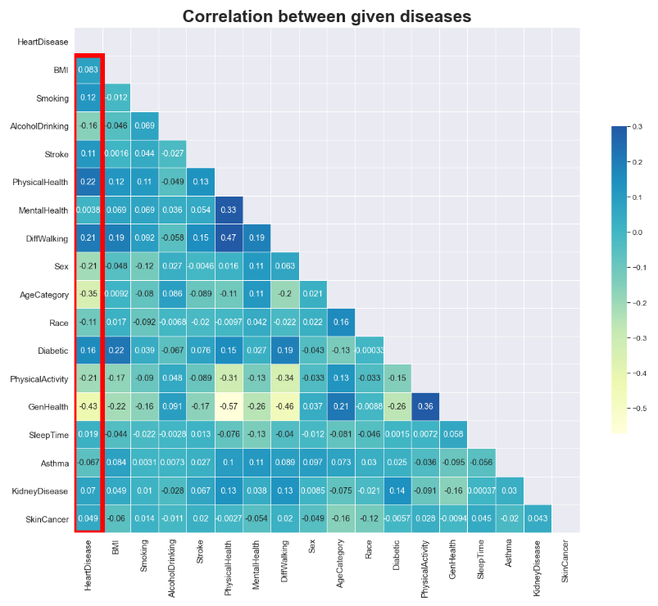

Slide 24
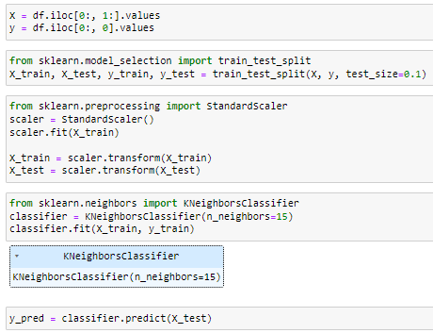
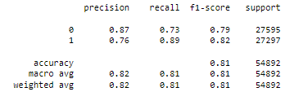
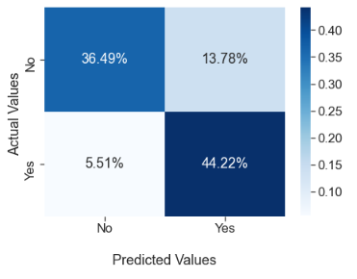
K-nearest neighbors

Slide 25
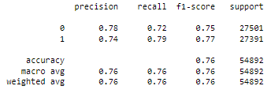
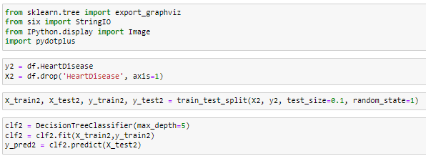
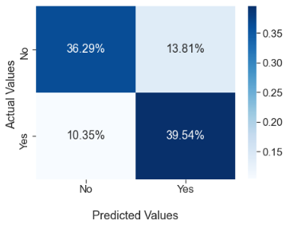
Decision Tree
(optimized version of the CART algorithm)

Slide 26
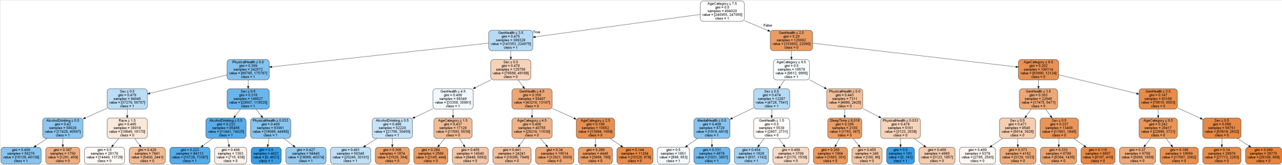
Part of the generated decision tree

Slide 27
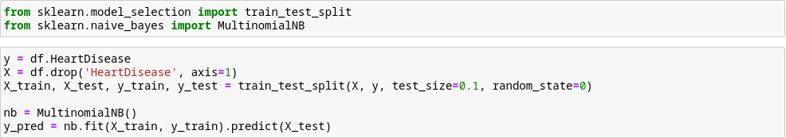
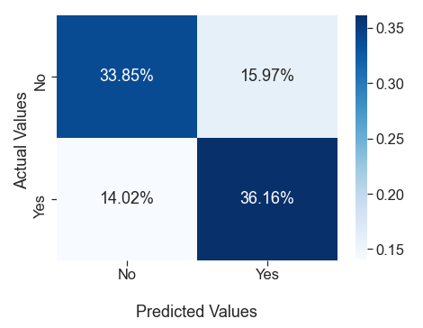
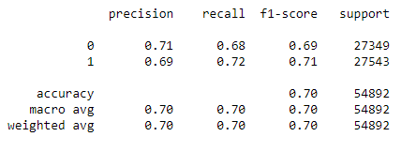
Naïve Bayes

Slide 28
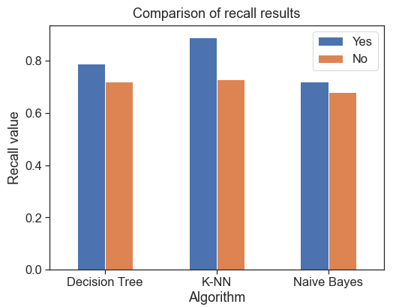
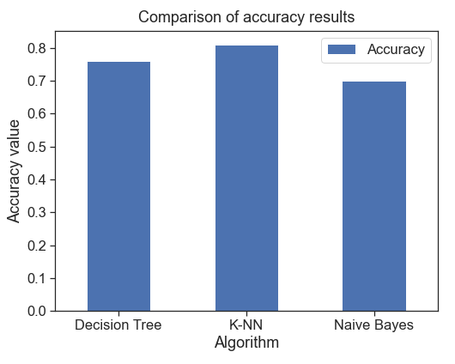
Comparison between the algorithms performance
Notes:
For medical models the goal is to minimize False Negatives, hence, to get as high as possible recall for “Yes”. It’s not as costly to say that there are some problems, when indeed there no, as we don’t want to predict “no issues”, when a patient might really have health problems.

Slide 29
Conclusion
All three algorithms used the same test set size of 10% of the dataset (which is equal to 54 892 samples).
According to the plots presented earlier, it can be seen that K-NN algorithm shows better results in both – recall and accuracy measures. Decision Tree got the second place in this case.
When it comes to time complexities of the algorithms, i.e.:
K-NN: O(k * n * d), where:
k – number of neighbors
n – number of points in the training dataset
d – data dimensionality
Decision Tree: O(m * n * log₂n), where:
m – numbers of attributes
n – number of samples
Naive Bayes: O(m * n), where:
m – numbers of attributes
n – number of samples
All of the used algorithms can be implemented equally easily using libraries. However, Naive Bayes’ actual implementation is much easier to do.
Notes:
The previous observations show us that K-NN was the best tried algorithm on both overall accuracy and “Yes” recall, followed by Decision Tree and Naive Bayes, although the latter was the easiest to implement.

Slide 30








Used main software/tools

Slide 31
Link to the project github repository:
https://github.com/alessandro1802/heart-diseases-classification

Slide 32
Thank you!

